Slide 1
Capstone III
Testing for Autism Spectrum Disorder

Slide 2
Autism Spectrum Disorder
Autism spectrum disorder (ASD) is, as defined by the National Institute of Mental Health, a neurological and developmental disorder that affects how people interact with others, communicate, learn, and behave.
While acknowledging the factors can help, not many people outside of ASD specialists and activists know what signs to look for.
Having information available that asks those factors out to the wider public can help with early diagnosis and help those who have the disorder find resources to help.

Slide 3
Data provided
Dataset is provided by Dr. Fadi Fayez Thabtah through the UC Irvine Machine Learning Repository.
Dataset is through an app that asks questions for the test taker that gives a score that suggests if the test taker could possibly have ASD.
The dataset contains 1100 test takers that are split into three age groups and looks at the answers given, and demographics provided.
Conduct t-tests and observe data through boxplot to see what the data provides.

Slide 4
Hypotheses
Hypothesis 1: Does the test score indicate ASD?
Hypothesis 2: Is having infant jaundice a factor in getting ASD?
Hypothesis 3: Does gender play a factor in getting ASD?
From these conclusion, we can see if using the app can provide support for spreading awareness and increasing treatment for ASD.

Slide 5
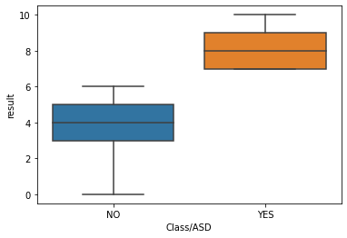
Hypothesis #1
Null Hypothesis: Test score in app does not indicate ASD
Alternate Hypothesis: Test score in app indicates ASD
P-value = 4.117 x 10⁻²⁸⁶ ; p < 0.05
Mean has a 95% confidence interval between 4.238 and 4.545
Reject the null hypothesis

Slide 6
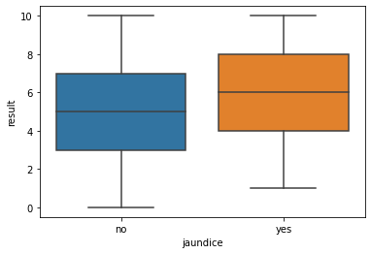
Hypothesis #2
Null Hypothesis: Infant jaundice is not a factor in ASD
Alternate Hypothesis: Infant jaundice is a factor in ASD
P-value = 8.573x10⁻⁵ ; p < 0.05
Mean has a 95% confidence interval between 0.427 and 1.242
Reject the null hypothesis

Slide 7
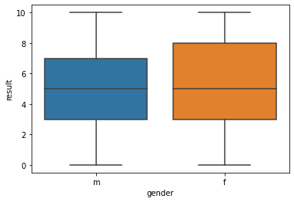
Hypothesis #3
Null Hypothesis: Gender is not a factor in ASD
Alternate Hypothesis: Gender is a factor in ASD
P-value = 0.8355
Mean has a 95% confidence interval between -0.334 and 0.270
Fail to reject the null hypothesis

Slide 8
Conclusions
The app shows that it can indicate if a test taker can have ASD
Infant jaundice can be a factor for ASD
Gender is not a factor for ASD

Slide 9
Recommendation
Spread awareness of testing app
General public: helps spread awareness of ASD and provide an easy way to find if you may have ASD
Primary care physicians: use of the app to patients to recommend treatment
App developer: provide resources to guide users to treatment

Slide 10
Sources
Autistic Spectrum Disorder Screening Data for Children Data Set (UC Irvine Machine Learning Repository): https://archive.ics.uci.edu/ml/datasets/Autistic+Spectrum+Disorder+Screening+Data+for+Children++
Autistic Spectrum Disorder Screening Data for Adolescent Data Set (UC Irvine Machine Learning Repository): https://archive.ics.uci.edu/ml/datasets/Autistic+Spectrum+Disorder+Screening+Data+for+Adolescent+++
Autism Screening Adult Data Set (UC Irvine Machine Learning Repository): https://archive.ics.uci.edu/ml/datasets/Autism+Screening+Adult
Autism Spectrum Disorder (National Institute of Mental Health): https://www.nimh.nih.gov/health/topics/autism-spectrum-disorders-asd

